Slide 1
NUCLEAR CARDIOLOGY
DR MUHAMMED RAMEEZ S

Slide 2
Braunwald's Heart Disease: A Textbook of Cardiovascular Medicine

Slide 3
History
Hermann blumgart 1927 injected radon to measure circulation time
Liljestrand 1939- normal blood volume measurement
Myron prinzmetal 1948 used radiolabelled albumin
Hal anger 1952 – gamma camera beginning of clinical nuclear cardiology
1976 thallium 201 used for 2D planar imaging

Slide 5
SPECT
PET
stress testing protocols
imaging protocols
systematic scan interpretation
methods to reduce radiation dose
Some clinical application

Slide 7
PRINCIPLE OF SPECT

Slide 8
Notes:
American Society of Nuclear Cardiology (ASNC) recommends a 180-degree angular image acquisition, with two heads in a 90-degree configuration, and 60 projection images (30 per detector), 3-degree rotation per stop, 25 to 30 seconds of imaging per stop (13-to 16-minute scan duration), and gated imaging. The images are then reconstructed using a computer algorithm before review.
These novel reconstruction algorithms lead to better spatial resolution and improved accuracy

Slide 9
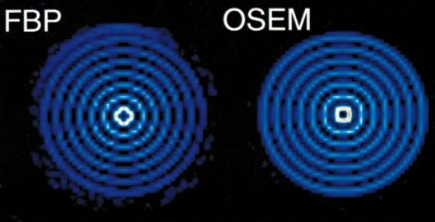
Reconstruction aprroach
filtered back projection (FBP)
ordered subset expectation maximization (OSEM).
Notes:
analytical reconstruction approaches such SUCH AS FBP These images were often smoothed to reduce statistical noise, resulting in degradation of spatial resolution and image quality.
Most current SPECT and PET scanners use iterative approaches such as
these algorithms over FBP are better handling of noise and improved accuracy
These novel reconstruction algorithms lead to better spatial resolution and improved accuracy
improved noise compensation
reduced dose and/or scan duration with improved image quality

Slide 10
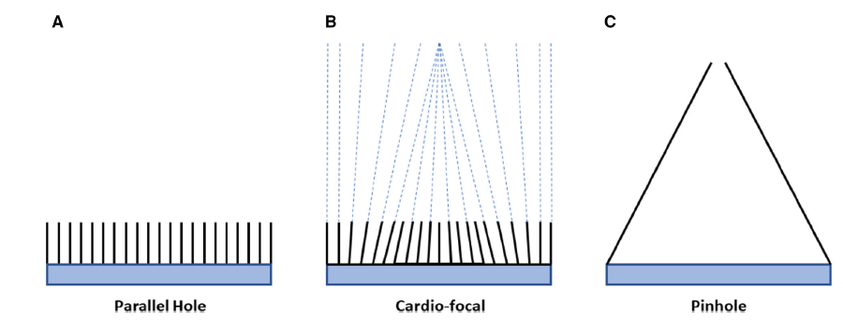
Solid-state detectors convert photon energy directly to electrons, eliminating the need for bulky photomultiplier tubes
cardiocentric design improved spatial resolution , low radiation dose
Notes:
innovative gantry designs with cardiofocal or 360-degree detector geometry
semiconductor detectors

Slide 11
PET - principle
C 11, N13 , O15, F 18 are positron emitting nucleotides
Annihilation
gamma rays or photons that are emitted at 180 degrees
captured by detector elements (scintillators) in the PET gantry
bismuth germanate (BGO), gadolinium oxyorthosilicate (GSO), lutetium oxyorthosilicate (LSO), and lutetium yttrium orthosilicate (LYSO)

Slide 12
Notes:
The PET scanner consists of a series of rings of detector blocks that are typically integrated with a computed tomography (CT) scanner in the PET/CT gantry. The collision of a positron with a nearby electron produces an annihilation reaction that typically releases two high-energy photons (511 keV) that are emitted at 180 degrees from each other and captured by opposite detectors to form a coincidence line

Slide 13
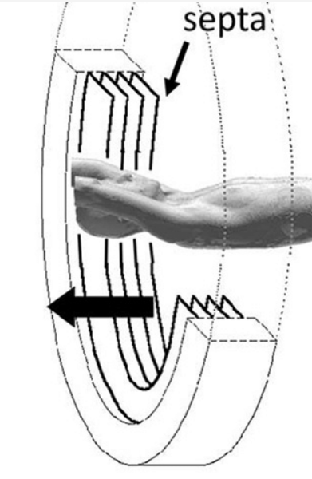
No collimator in PET so sensitive than spect
Attenuation
Attenuation correction is, necessary for PET.
Current generation PET scanners no lead septa
Newer- solid-state detectors with silicon photomultipliers with very high count rate capabilities
reduce radiation dose and rapid imaging
Notes:
If one of the two photons is attenuated by tissue and does not reach a detector, the entire event is rejected by the system
Current generation PET scanners are manufactured as 3D scanners without lead septa increases scatter and reduces effective spatial resolution
Newer digital PET scanners include solid-state detectors with silicon photomultipliers with very high count rate capabilities

Slide 14
ADVANTAGES OF PET
High spatial and contrast resolution
Capability for tomographic dynamic imaging with high temporal resolution
Accurate and depth-independent attenuation correction
High count sensitivity, making possible rapid protocols
Low radiation dose protocols (due to short half-life of the PET tracers)
Quantitation of absolute radiotracer concentration in tissue, including myocardial blood flow
CT hybrid imaging for quantification of atherosclerotic burden and localizing hot spot imaging tracers
Targeted tracers can image in micro nano level

Slide 15
SPECT AND PET IMAGE ACQUISITION
List mode, static , ecg gated, dynamic
List mode : information is stored for every event and they are summed and reconstructed as static image
ECG-gated images allow assessment of RWMA, EF
gated SPECT or PET gives tomographic images and measure LV EF, Ventricular dyssynchrony can also be assessed
Dynamic imaging
Notes:
tracking of radiotracer through the blood and heart, Myocardial blood flow estimates can be derived by this approach, ratio of stress to rest myocardial blood flow is termed myocardial flow reserve (MFR).

Slide 16
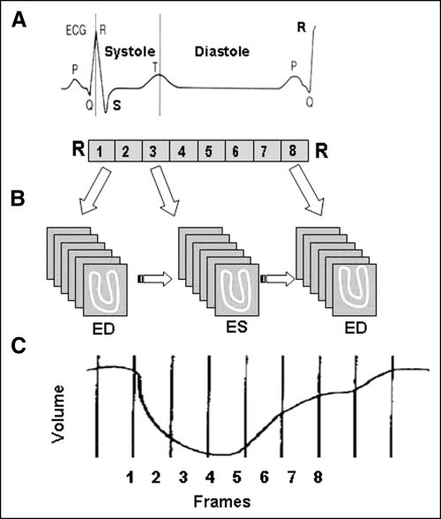
Notes:
Principle of ECG-gated acquisition. R–R interval on ECG, representing 1 cardiac cycle, is typically divided into 8 frames of equal duration (A). Image data from each frame are acquired over multiple cardiac cycles and stored separately in specific locations (“bin”) of computer memory (B). When all data in a bin are added together, image represents a specific phase of cardiac cycle. Typically, a volume curve is obtained, which represents endocardial volume for each of 8 frames (C). ED = end-diastole; ES = end-systole

Slide 17
Notes:
Ecg gated pet are reviewed for regional wall motion, wall thickening, and calculation of LV volumes and EF. Dyssynchrony can also be evaluated using specialized software

Slide 18
Radiotracers and Protocols
Myocardial Perfusion Imaging Tracers
SPECT MPI Tracers
PET MPI Tracers
Myocardial Metabolic Imaging Tracers

Slide 19
Myocardial Perfusion Imaging Tracers.
Ideal radiotracer
most radiotracers show linear extraction at relatively low blood flow rates, as in the resting state, obstructive CAD
As the blood flow increases as in pharmacological stress or exercise radiotracer extraction falls off
Accuracy can be increased by using radiotracers with greater extraction at high flow rates
nonobstructive CAD, diffuse CAD, or microvascular dysfunction.
15O-water is close to an ideal tracer
82rubidium, 13N-ammonia, and 15O-water can all be used to quantify myocardial blood flow

Slide 21
Notes:
Effect of radiotracer “roll-off” on myocardial perfusion images. In the graph, regional myocardial uptake of a radiotracer uptake is plotted against regional coronary blood flow. The radiotracer shows significant roll-off at flows exceeding 2.5 mL/min/g. In the relative low flow range, because of good linearity of uptake, a myocardial region with 0.75 mL/min/g has significantly less radiotracer uptake than a region with1.5 mL/min/g, resulting in an abnormal image with defect (left image). However, at higher flow ranges, a similar 0.75 mL/min/g flow difference may result in no significant difference in myocardial radiotracer uptake and in a normal image without perfusion defect

Slide 22
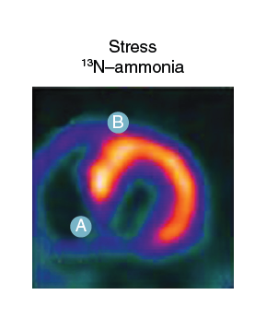
Notes:
Patient with an approximately 50% coronary stenosis imaged with 99mTc-sestamibi. The marked roll-off of sestamibi uptake at high flow rates leads to minimal contrast between tracer retention in the diseased coronary territory (point A) and the normal coronary artery (point B) and a relatively normal image. Bottom: Improved defect contrast when the same patient is imaged with 13N ammonia, which has a less marked roll-off in tracer retention at high flow rates. (Adapted from Salerno M, Beller GA. Noninvasive assessment of myocardial perfusion.

Slide 23
SPECT MPI Tracers
99mTc-sestamibi, 99mTc-tetrofosmin, and 201thallium are FDA-approved SPECT myocardial perfusion tracers
99mTc is produced by a 99m molybdenum generator
then compounded into 99mTc-sestamibi or 99mTc-tetrofosmin
99mTc emits 140-keV gamma rays and have a half-life of 6 hours.

Slide 24
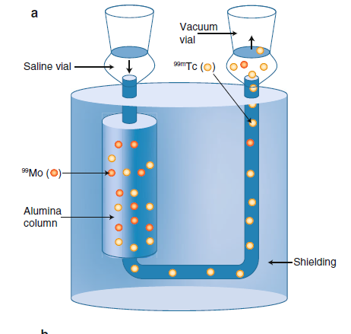
Notes:
Generators are
devices that allow the separation of a radionuclide from a
relatively long-lived parent, allowing the production of
short-lived radionuclides at a location remote from a reactor
or cyclotron (such as a hospital, clinic, or local radiopharmacy

Slide 26
201 thallium
by a cyclotron
lower energy photons (80 keV) has a half-life of 73 hours
defects in images represent reduced blood flow from ischemia or scar
Perfusion defects may resolve over time because of redistribution of 201thallium in ischemic and hibernating regions;
therefore poststress images within 10 to 15 minutes after injection.
long half-life and relatively low photon energy
higher radiation dose
Not recommended for perfusion imaging
Used for viability assessment where cardiac MR or PET is not available

Slide 27
Pet - Radiotracers

Slide 28
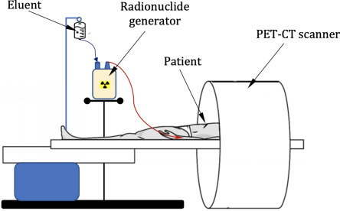
PET MPI Tracers
and 13N-ammonia are FDA-approved PET perfusion tracers
15O-water and 18F-flurpiridaz are novel tracers that are currently under development
82Rubidium Na+/K+ ATPase pump . very short half-life (76 seconds )
it is produced from a 82strontium/82rubidium generator
exercise stress imaging is not feasible
rapid sequential imaging is possible.

Slide 29
PET MPI Tracers
13N-ammonia enters the cardiomyocytes passively
Converted into 13N-glutamine and trapped in the glutamate pool.
short (9.96 minutes) half-life
on-site cyclotron is required
exercise PET is feasible
lower injected doses are administered compared with 82rubidium
PET MPI Tracers have superior extraction that SPECT tracers hence they are more suitable for quantifying myocardial blood flow

Slide 30
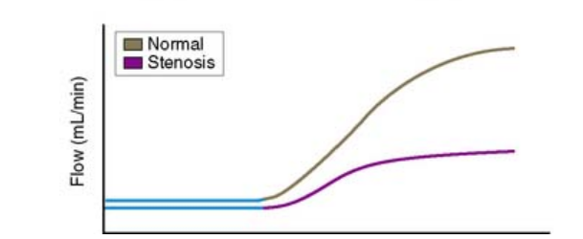
PHYSIOLOGY OF STRESS TESTING
Notes:
oxygen demand from high heart rate, contractility, and ventricular work that is met physiologically by increased blood supply from metabolic vasodilation
critical stenosis (>90%), where the microvasculature is maximally vasodilated at rest, vasodilation of the epicardial coronaries by vasodilator stress agents can redistribute flow away from the subendocardium causing coronary steal,

Slide 31
Balanced ischemia
if there is severe multivessel obstructive CAD and coronary blood flow is reduced in all vascular territories, this can result in an apparently normal appearing relative myocardial perfusion image with no perfusion defects, also known as balanced ischemia

Slide 32
Pharmacologic Stress
those unable to exercise
Adenosine, dipyridamole, and regadenoson
Adenosine Binding to A2A receptors causes coronary vasodilation,
A1 - heart block , A2B- wheezing and A3- peripheral vasodilation
Regadenoson is a specific A2A receptor agonist
contraindicated in patients with active wheezing, high-grade atrioventricular (AV) block ,(BP) <90 mm Hg
regadenoson - seizures – not given in those with structural brain injury
adenosine (140 mcg/kg/min) and dipyridamole (0.56 mg/kg) are weight-based infusions administered over 4 minutes,
regadenoson is a fixed-dose rapid IV bolus over 10 seconds

Slide 33
Vasodialtor agents cause - symptoms of hyperemia, urge to breathe deeply, chest tightness, headache, flushing
10 to 20 beat inc heart rate, and a 10-mm Hg decrease in systolic BP.
exercise, or low-level treadmill exercise, improves symptoms and reduces heart block, which is common during adenosine infusion
splanchnic hyperemia and intense radiotracer uptake in the liver that may scatter into the inferior wall of the left ventricle

Slide 34
Methylxanthines are competitive agonists of the adenosine receptors and can reverse the vasodilatory effects of adenosine dipyridamole, and regadenoson
12 hours before adenosine it is hold
IV aminophylline is used as an antidote for side effects of vasodilator stress agents
In ACS and uncomplicated MI its safe to do testing within 24 – 48 hrs

Slide 35
Dobutamine - weight-based infusion starting at 10 mcg/kg/min every 3 minutes by 10 mcg/ kg/min to a maximum of 40 mcg/kg/min
If target heart rate is not achieved, atropine is administered as 0.5 mg IV followed by increments of 0.25 mg IV to a maximum of 2 mg IV

Slide 36
Imaging protocols
optimal protocol- best image quality+ lowest radiation dose and in the most expeditious manner.

Slide 37
PREPARATION FOR STRESS TESTING-
4 to 6 hour fast before a stress ,SMOKING 6 hrs , caffeine 12 hrs theophylline-48
known CAD should continue therapy
others withholding their beta blockers and antianginal medications for 12 hours before testing
On the day after dialysis
18F-FDG for Viability Testing 6-hour fast. On arrival, fingerstick glucose level is checked if fasting < 250 give oral glucose if >250 give insulin after blood sugar less than 150 we give 18FDG
18F-FDG for Inflammation/Infection high-fat, low to zero carbohydrate diet for at least two large meals 24 hours before the test followed by overnight fast (8 to 12 hrs) IV heparin f/b IV FDG
Amyloidosis Imaging and Gated Blood Pool Scans- no specific diet preparation is needed

Slide 41
Spect protocols
With SPECT MPI the imaging protocol can be personalized to the patient and the clinical question
99mTc-radiotracers with gated SPECT imaging is recommended
Stress first and single-day rest followed by stress MPI are the mostly widely used protocols
Two-day protocols with stress first followed by rest on another day if stress MPI is abnormal are used in patients with large body habitus

Slide 42
Notes:
In a stress-first protocol, stress MPI is performed first and only followed by rest imaging when stress images are abnormal
Most preferred for patients without prior CAD because it is most efficient and associated with the lowest radiation dose to the patient
careful patient selection, review of the stress images as soon as they are completed, and a definitive scan interpretation as normal.
Most patients are candidates for stress-first imaging, except for patients with documented prior MI
those needing viability assessment, or those presenting with ACS who may benefit from rest and stress imaging

Slide 43
For single-day 99mTc-rest-first MPI, the low rest radiotracer dose (4 to 8 mCi) is typically followed by a larger stress radiotracer dose (12 to 25 mCi, approximately three times the initial dose) to overcome the shine through of the first injection
for two-day protocols where an equal amount of radioactivity is used,
Two-day protocols provide the lowest possible radiation dose and optimal image quality because there is no shine through of rest radiotracer activity.

Slide 45
SPECT and PET perfusion tracers → 60 to 90 sec → reach cardiomyosite
SPECT MPI scans are typically- 15 to 45 minutes after stress radiotracer injection
PET MPI-gated images are obtained immediately after completion of vasodilator stress and during peak dobutamine infusion
A lack of increase in LVEF with vasodilator stress or a decrease in LVEF post vasodilator stress with 82rubidium
Transthyretin Cardiac Amyloidosis Imaging 99mTc-PYP, 99mTcDPD, 99mTc-HMDP
Notes:
Hence, most patients with reversible perfusion defects do not demonstrate regional wall motion abnormalities on the gated SPECT studies, unless ischemia is severe leading to postischemic stunning.
A lack of increase in LVEF with vasodilator stress or a decrease in LVEF post vasodilator stress with 82rubidium PET has been shown to be a marker of significant obstructive multivessel CAD (see section Patient-Centered Clinical Applications

Slide 46
PET Protocols
Myocardial Perfusion Imaging For PET, a single-day rest and stress MPI is performed with 82rubidium or 13N-ammonia
advanced scanners, images are acquired in a list mode and reconstructed into static, gated, and dynamic images.
hybrid PET/CT a dedicated noncontrast gated cardiac CT can be obtained for calculation of a coronary artery calcium score
Notes:
scout scan to position the heart in the field of view
nongated, low-dose CT transmission scan for attenuation correction;
emission scan.
MPI is typically performed in association with pharmacologic stress
exercise PET MPI is possible with 13N ammonia because of its longer physical half-life.

Slide 47
¹⁸F-FDG Metabolic Imaging Protocols
For viability imaging, glucose/insulin preparation is necessary. Then, 18F-FDG (5 to 10 mCi) is administered intravenously and cardiac PET/CT images are acquired 60 minutes later
infection, or vasculitis imaging (see ), patients undergo the high-fat/low-carbohydrate dietary preparation. For cardiac sarcoidosis
Cardiac and partial or full-body PET/CT images are acquired 90 minutes after IV injection of 18F-FDG
A coronary CTA, and a vascular CTA or MR angiogram (MRA), is also added for endocarditis and vasculitis protocols, respectively.

Slide 48
Pet ct protocol
Notes:
18F-FDG PET/CT protocols for myocardial viability, sarcoidosis, and infective endocarditis/vasculitis assessment. Specific dietary preparation is required for each of these

Slide 49
Pet ct protocols

Slide 50
SYSTEMATIC INTERPRETATION OF IMAGES
Following image acquisition motion artefacts are corrected
Image Display short-axis, vertical-long axis, and horizontal-long axis
Conventionally stress images on the top and rest images on adjascent row

Slide 51
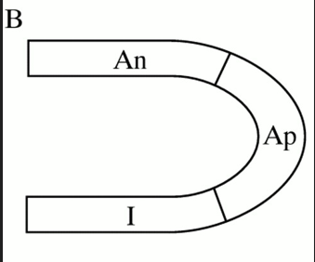
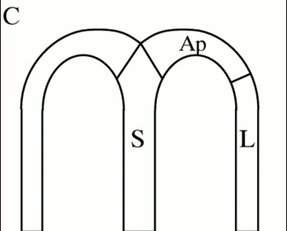

Slide 52
Perfusion imaging interpretation
Interpretation is performed in a segmental fashion using a 17-segment heart model
0 = normal,
1 = mild,
2 = moderate,
3 = severe, and
4 = absent tracer uptake
summed stress score (SSS), summed rest score (SRS), and summed difference score (SDS) are calculated

Slide 53
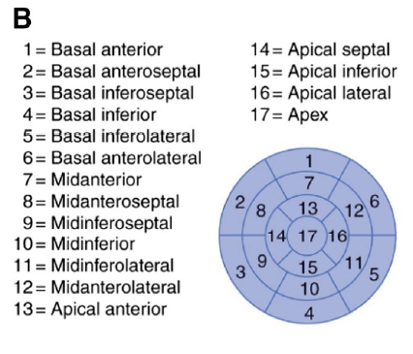

Slide 54
Polar map
Notes:
Data from the individual short-axis tomograms can be combined to create a
polar map plot, representing a 2D compilation of all the 3D short-axis perfusion data. Standard
nomenclature for the 17 segments is outlined.

Slide 55
Notes:
Interpretation of myocardial perfusion images. Patterns of regional myocardial perfusion and corresponding regional wall motion associated with scans showing normal myocardial perfusion, attenuation artifact, scar, and ischemia

Slide 56
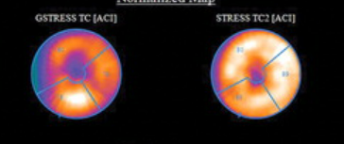
Apical thinning
Apical thinning is a well-known phenomenon in myocardial perfusion SPECT, often attributed to reduced myocardial thickness at the apex of the left ventricle. Attenuation correction processing appears to exaggerate this effect.

Slide 57
fixed basal lateral perfusion defect with normal wall motion on 13N-ammonia PET/CT
differential diagnosis of a fixed perfusion defect includes artifact (if wall motion is normal) or real defect (if wall motion is abnormal)

Slide 58
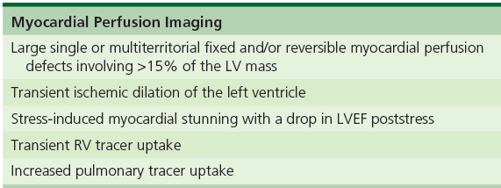
High-risk features of MPI

Slide 59
PET Viability Imaging Interpretation
mismatch
match
perfusion-metabolism partial match.
Resting counts are normalized to peak counts and expressed as percentage of peak activity
Myocardial segments with >60% peak activity of perfusion tracer are considered viable, those with <40% peak activity are considered nonviable, and those with 40% to 60% of peak activity are further evaluated for myocardial viability

Slide 60
Notes:
Patterns of myocardial perfusion and 18F-FDG in viability imaging

Slide 61
Hot-spot images seen in sarcoidosis, amyloidosis, and infective endocarditis
are quantified using ratio (myocardium to rib uptake in amyloidosis and myocardium to blood activity in sarcoidosis),

Slide 62
Notes:
Patterns of myocardial perfusion and 18F-FDG images in cardiac sarcoidosis

Slide 63
Photon Attenuation and Attenuation Correction
photons emitted by the heart may be attenuated (stopped by soft tissue) or scattered before they reach the detectors eg soft tissue
prominent in obese patients
large chest size, and in those who are unable to raise their left arm for MPI
AW attenuation in women from overlying breast tissue
IW attenuation in men - diaphragmatic muscle are common sources of attenuation artifacts

Slide 64
multiposition imaging, ECG-gated SPECT imaging, or radionuclide or CT-based transmission imaging for attenuation correction
Most attenuation artifacts typically result in fixed defects
radionuclide or CT transmission imaging is the most direct way to correct for attenuation artifacts

Slide 65
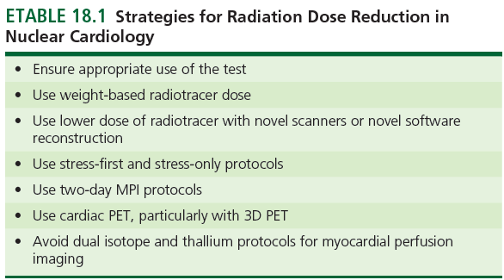
Dose reduction
Stochastic effect

Slide 66
Ischemic heart disease

Slide 68
Notes:
when moderate-to-severe ischemia (>10% of the total myocardium ischemic) was detected by MPS, patients undergoing revascularization have shown an increased survival benefit over patients undergoing medical therapy

Slide 69
Suspected CAD with new onset chest pain
Younger- coronary CT angiography
older patients,
diagnostic accuracy of SPECT MPI for detecting obstructive CAD pooled sensitivity was 87% and the specificity was 78%
limitation of images with SPECT and PET often uncovers only coronary territories supplied by coronary arteries with the most severe stenosis.
Extent of obstruction is not obtained
MFR - calculated as the ratio of maximum hyperemic myocardial blood flow over that at rest
there is a progressive reduction in myocardial blood flow and flow reserve with increasing severity of angiographic stenosis
MFR >2.0 is associated with a >97% negative predictive value for ruling out high- risk angiographic CAD

Slide 71
Symptomatic Patients Without Angiographic Obstructive Coronary Artery Disease
CMD is similar in women and men
patients with CMD have a worse prognosis than asymptomatic patients.
diffuse process, conventional exercise stress testing, echo or SPECT, less sensitive in detecting CMD and thus have a relatively limited role in its diagnosis
Quantitative PET imaging is considered the most accurate and reproducible noninvasive technique.
Reduction of stress myocardial blood flow and MFR reflects the combined effects of altered coronary fluid dynamics caused by diffuse atherosclerosis and microcirculatory dysfunction

Slide 72
Evaluation Before Organ Transplantation
Lilimited number of organs → free of severe CAD
It may be reasonable to consider noninvasive testing in patients with multiple risk factors for CAD
Coronary CTA → in young patients
patients over the age of 55, especially those with chronic kidney disease- Ca
exercise stress testing is preferred, if not pharmacologic stress testing.
abnormal MPI is associated with both short- and long- term adverse cardiac events in patients with chronic kidney disease
PET perfusion imaging + flow quantification offers better prognostic information,

Slide 73
Suspected Acute Coronary Syndrome
Patients with Nondiagnostic Electrocardiogram and Troponin Elevation
abnormal perfusion study identifies patients at significantly higher clinical risk.
perfusion imaging helps guide the subsequent need of referral to cardiac catheterization and revascularization
association between chronic microvascular ischemia and myocardial injury, especially among patients with diffuse atherosclerosis

Slide 74
Prior PCI and recurrent symptoms
In patients with prior PCI or CABG ,
In these patients, exercise stress is ideal and should be performed when feasible
Among patients with known CAD, both PET and SPECT MPI offer high sensitivityPET has higher specificity
Notes:
In patients with prior PCI or CABG , radionuclide MPI provides localization and quantification of myocardial ischemia that helps with risk prediction and management decisions regarding the potential need for targeted revascularization

Slide 75
Notes:
SPECT MPI in a patient with prior PCI and recurrent symptoms. Vasodilator-stress and rest 99mTc-sestamibi SPECT MPI of a 58-year-old woman who underwent PCI of the left circumflex (LCX) and left anterior descending (LAD) coronary arteries 3 years ago, now presenting with atypical angina and dyspnea. During vasodilator stress, there was 1-mm downsloping ST-segment depression in the inferolateral leads, which resolved 5 minutes into recovery. Myocardial perfusion images and associated polar maps demonstrate a large perfusion defect of severe intensity in the mid and apical anterior and anterolateral walls with significant but not complete reversibility. Follow-up coronary angiography demonstrated a long segment of severe diffuse disease in the mid-distal LAD including a diagonal branch, and a 50% proximal LCX lesion with total occlusion of the first marginal branch.

Slide 76
CTO
demonstration of significant myocardial ischemia and viability within the territory supplied by a coronary vessel with a CTO is generally accepted as a useful approach to help inform the risk versus benefit of CTO PCI
PET imaging quantitative blood flow and flow reserve
PATIENTS WITH PRIOR MI AND VENTRICULAR ARRHYTHMIA
Scarring can be detected

Slide 77
Newly Diagnosed Left Ventricular Systolic Dysfunction
invasive coronary angiography or noninvasive imaging including coronary CTA or radionuclide MPI.
severe angina should be referred to coronary angiography
without angina or history of MI
coronary CTA may be an attractive option, especially in younger patients
radionuclide MPI → preferred in older patients with chronic kidney disease
very high negative predictive value
PET MPI may be preferred as it allows quantification of myocardial blood flow and MFR
absence of perfusion defects involving a typical coronary artery territory and normal MFR would support a diagnosis of nonischemic cardiomyopathy

Slide 78
Notes:
Myocardial perfusion imaging in a patient with cardiomyopathy. Vasodilator stress and rest 13N-ammonia PET images of a 74-year-old woman with hypertension, diabetes, and chronic kidney dysfunction who presented with new-onset exertional dyspnea. The ECG showed left bundle branch block (LBBB). PET MPI shows a severely dilated left ventricle and a small septal perfusion defect showing apparent reversibility, likely secondary to LBBB. The ECG-gated images demonstrated an ejection fraction of 15% that rose to 20% during peak stress, and evidence of septal dyssynchrony. Myocardial flow reserve was preserved in all coronary territories. These findings are consistent with a nonischemic cardiomyopathy, which was subsequently confirmed on coronary angiography LBBB, left bundle branch block

Slide 79
Myocardial Viability Imaging to Guide Revascularization in Patients with Ischemic Heart Failure
Myocardial viability testing to guide coronary revascularization
Adrián I. Löffler, MDa and Christopher M. Kramer, MDa,b
aDivision of Cardiovascular Medicine, University of Virginia Health System, Charlottesville, Virginia, USA
bDepartment of Radiology and Medical Imaging, and the Cardiovascular Imaging Center, University of Virginia Health System, Charlottesville
Notes:
Death rates for patients with and without myocardial viability treated by revascularization or medical therapy. (b) same data as (a) with comparisons based on treatment strategy in patients with and without viabili
, Virginia, USA

Slide 80
Good improvement with revasc - if large areas of hibernating and/or stunned myocardium (∼20% of the LV mass)
extent of nonviable or scarred myocardium by 18F-FDG PET correlates inversely with changes in LVEF after revascularization.
ischemic, viable myocardium among patients with severe LV dysfunction identifies patients at higher clinical risk
PARR-2 clinical trial were randomized to PET-guided management versus standard clinical care did not demonstrate an overall benefit of PET

Slide 81
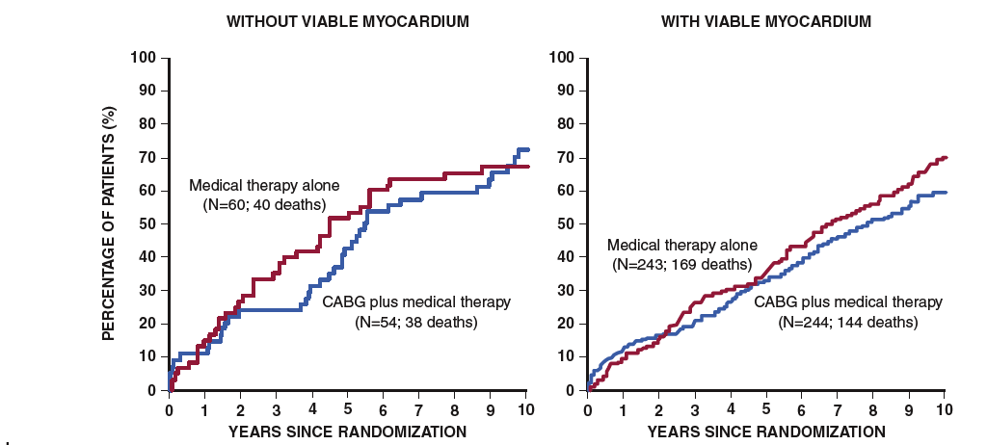
Surgical Treatment of Ischemic Heart Failure (STICH) trial, especially its ancillary viability substudy

Slide 82
In summary, the STICH trial and its imaging substudies suggest that among patients with heart failure and end-stage LV remodeling, identification of moderate ischemia or viability is not associated with a significant survival advantage from revascularization

Slide 83
Cardiac amyloidosis
Misfolded proteins AL amyloidosis, wild-type ATTR or hereditary ATTR
Present with HFpEF
AL amyloidosis → chemotherapy TTR-CA is treated by TTR stabilization (tafamidis)
neuropathy is treated by silencing TTR gene products (patisiran and inotersen)
bone-avid radiotracers increased up take in ATTR> AL cardiac amyloidsis
99mTc-PYP/ DPD/HMDP scan for ATTR-CA
Grade 2 or 3 +ve 99mTc-PYP/DPD/HMDP ATTR amyloidosis with nearly 100% specificity and 71% sensitivity
tracers to image AL cardiac amyloidosis. serum amyloid P-component SPECT is used in the United Kingdom
18F-florbetapir that early cardiac AL amyloid deposits can be identified using 18F-florbetapir and 11C-Pittsburgh-B-Compound imaging before clinically evident changes in cardiac structure (increased LV thickness) or cardiac biomarker release.

Slide 84
Notes:
Role of bone scintigraphy in the diagnosis of cardiac amyloidosis. A, Echocardiogram in a 78-year-old man with heart failure and recently diagnosed cardiac amyloidosis showed severe concentric left ventricular (LV) thickening (18 mm) and moderately reduced LV ejection fraction (35%). B, The 99mTc-PYP SPECT/CT scan showed intense myocardial PYP uptake (grade 3) on the planar and (C and D) SPECT/CT images. E, Endomyocardial biopsy with sulfated Alcian blue staining and immunohistochemistry-confirmed transthyretin (TTR) cardiac amyloidosis. Serum free light chain assay and serum and urine immunofixation were normal and excluded light chain amyloidosis. A genetic test excluded TTR mutations and confirmed wild-type A TTR amyloidosis.

Slide 86
Sarcoid cardiomyopathy
20-25% cardiac involvement is seen
focal noncaseating granulomas with multinucleated giant cells
inflammation → resolution → fibrotic phase
syncope, sudden death, heart block, atrial or ventricular tachyarrhythmias, and heart failure
biopsy has a low yield focal nature of the cardiac sarcoidosis , MC affected LV

Slide 87
PET scan demonstrates multiple focal regions of intense myocardial uptake including the apical anteroseptal and mid and basal lateral walls
supraclavicular, mediastinal, and right-sided internal mammary lymph nodes

Slide 88
The perfusion images show a small perfusion defect in the basal inferoseptal wall without corresponding 18F-FDG uptake consistent with myocardial scar

Slide 89
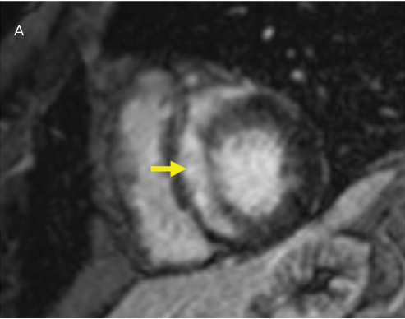
Management of Cardiac Sarcoidosis in 2020
Nisha Gilotra David Okada Apurva Sharma Jonathan Chrispin

Slide 91
Follow-up PET images of the patient described in Fig. 18.36 after 6 months of anti-inflammatory therapy showed complete resolution of myocardial and extracardiac 18F-FDG uptake. The severe perfusion defect in the basal inferoseptal wall remained unchanged and consistent with focal myocardial scarring.

Slide 92
Infective endocarditis
combination of 18F-FDG PET + cardiac CTA yielded higher diagnostic performance
high-fat/low-carbohydrate diet and undergo dedicated cardiac imaging followed by whole-body imaging
intense radiotracer uptake is consistent with infection.
18F-FDG PET for prosthetic valve and native valve endocarditis, intracardiac device infection, and LV-assist device infection
>3 months prior
radiolabeled leukocyte SPECT/CT, or cardiac CT showing a definite paravalvular lesion

Slide 93
Selected axial 18F-FDG PET and fused PET/CT images showing focal FDG uptake in the aortic valve annulus.

Slide 94
Notes:
18F-FDG image at the level of the pulmonary artery bifurcation shows increased soft tissue density around the aortic root (arrow) with increased metabolic activity suspicious for abscess

Slide 95
18F-FDG uptake in the spleen consistent with a splenic infarct, likely embolic

Slide 96
VASCULITIS
false-negatives common with biopsies
Anatomic imaging methods identify wall thickening, thrombus, luminal stenosis, and aneurysms → late
May continue to demonstrate vessel wall abnormalities even in the fibrotic phase of vasculitis.
18F-FDG PET/CT is the test of choice to ascertain the presence of inflammation in large-vessel vasculitis
PET/CT can guide the most appropriate site of biopsy
high-fat, low-carbohydrate diet for 24 hours, especially for evaluation of the aortic root
90 minutes after injection of radiotracer

Slide 97
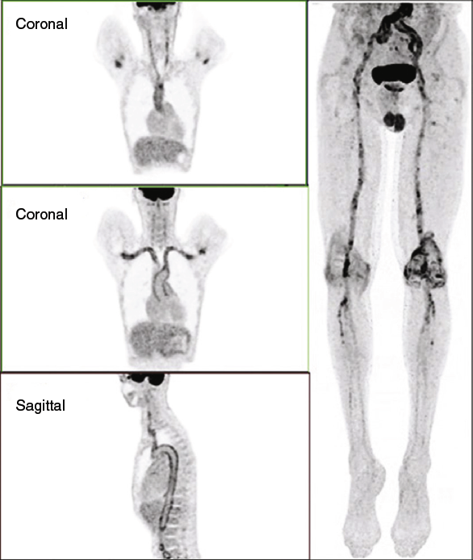
Notes:
thoracic and abdominal aorta and subclavian, carotid, and femoral arteries bilaterally, consistent with large-vessel vasculitis.

Slide 98
Cardio oncology
cardiotoxicity from cancer therapy
age, sex, agent(s) used, cumulative dose, concomitant treatment with other cardiotoxic therapies
1 year of completing anthracycline therapy( doxorubicin ≥ 250 mg/m2 )
concomitant high-dose radiation therapy (≥30 Gy)
lower-dose anthracycline therapy in combination with lower-dose radiation therapy
those receiving treatment with lower-dose anthracycline followed by trasutuzmab.
discontinuation of doxorubicin if there is an absolute decrease in LVEF of ≥10% from baseline to ≤50%.
Radiolabelled blood pool imaging is used for ejection fraction calculation

Slide 99
Novel PET Perfusion Tracers
18F-flurpiridaz is a novel 18F-labeled PET perfusion tracer
mitochondrial complex
higher extraction than 13N-ammonia even at high myocardial blood flow rates
long half-life (110 minutes [possible to transport
its superior accuracy in relation to SPECT MPI.
Perfusion defect size, image quality, and radiation dose were better delineated by 18F-flurpirdaz PET compared with 99mTc-SPECT MPI

Slide 100
Notes:
18F-flurpiridaz PET/CT versus 99mTc-SPECT MPI. Stress/rest 99mTc-sestamibi images (top) and 18F-flurpiridaz PET/CT images (bottom) of the same patient. SPECT images were normal, whereas PET/CT images showed a large region of ischemia in the anterior wall, anteroseptal wall, and apex. (From Berman DS, et al. Phase II safety and clinical comparison with single-photon emission computed tomography myocardial perfusion imaging for detection of coronary artery disease

Slide 101
Aortic stenosis
Many severe AS patients remain asymptomatic
Inflammation and microcalcification → mechanisms that lead to progressive aortic stenosis
18F-NaF PET correlate closely with increase in aortic valve calcification

Slide 102
MCQs
WHICH IS CLOSE TO THE IDEAL RADIOTRACER
N13 AMMONIA
201 THALLIUM
015 WATER
99M SESTAMIBI

Slide 104
Drug to be stopped before vasodialatory stess test
Methyl xanthines
Betalactum antibiotics
Ppis
CCBs

Slide 105
Drug to be stopped before vasodialatory stess test
Methyl xanthines
Betalactum antibiotics
Ppis
CCBs

Slide 106
What is the diagnosis

Slide 107
thank you

